Slide 1
CZ4041 Research Presentation Domain Adaptation
Wong Yuh Sheng Reuben
Wee Chin Ho Andrew
Dinh Khoat Hoang Anh
Tan Yi Zhuang
Alvin Woo
Notes:
Hello everyone, today our group will present on the topic of domain adaptation.

Slide 2
Overview
Literature Review
Implementation
Discussion
Results
Methodology
Notes:
We will first start with literature review, then move on to methodology, implementation, experimental results, and finally, discuss pros and cons of different models.

Slide 3
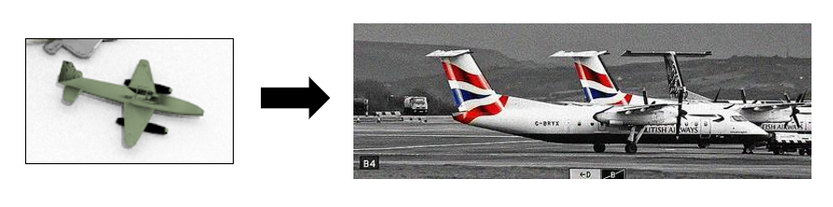
DOMAIN ADAPTATION
Aim to make model insensitive to data from source and target domains
VisDA18 dataset: synthetic to real images
Notes:
The goal of domain adaptation is to make the model insensitive to data from both the source and target domains, which means minimizing the impact of domain change. This means the domain adaptation task will attempt to apply the learnt knowledge from a labeled source dataset to a different unlabeled target dataset, while maintaining the same goal.
This project examines the Visual Domain Adaptation Challenge domain adaptation problem. The source domain contains synthetic images rendered from 3D models across 13 object categories, while the target domain contains real images of these objects. This project therefore aims to study different model variations’ effectiveness on the synthetic to real life domain adaptation problem and benchmark them on the same basis of comparison.

Slide 4
LITERATURE REVIEW
Notes:
For literature review

Slide 5
Transfer learning & Domain adaptation
Present Elements | Standard Machine Learning | Transfer Learning | Domain Adaptation
Domain mismatch | No | Yes | Yes
Multiple sources | No | Yes/No | No
Target domain | No | Yes | Yes
Similar source-target task | Yes | Yes/No | Yes
Literature Review | Methodology | Implementation | Results | Discussion
Notes:
Transfer Learning is a technique for using the information learned from a source task to apply in a different but related target task.
The three main types of transfer learning are inductive transfer learning, transductive transfer learning and unsupervised transfer learning.
Domain adaptation is a subset of transfer learning. Given a source domain and a target domain, where the two domains and learning tasks are distinct, the goal is to improve the learning of the target predictive function in target using the knowledge learnt in source.
The following table therefore summarizes the differences between standard machine learning, transfer learning and domain adaptation.

Slide 6
Related Works
Domain Adaptation
Classifier adaptation
Feature-based transformation
Deep learning
Reweighting
Adaptive SVM
Domain Adaptation Machine
TrAdaBoost
Double weighted DA
Transfer Component Analysis
Geodesic Flow Kernel
PCA subspace
Deep Domain Confusion
Deep Adaptation Network
Generative Adversarial Network
Literature Review | Methodology | Implementation | Results | Discussion
Notes:
There have been many proposed methods for domain adaptation.
The traditional domain adaptation techniques can be broadly categorized into three types: classifier adaptation approach, reweighting approach, and feature transformation-based approach.
Recently, there is a rising attention in deep learning approach that offers a positive result in many state of the art papers.

Slide 7
Methodology
Notes:
Coming to methodology

Slide 8
METHODOLOGY OVERVIEW
Five baseline models:
Source Hypothesis Transfer (SHOT)
Self-ensembling Mean Teacher Variant (Mean Teacher)
CycleGAN
CyCADA
Unsupervised Pixel-Level Domain Adaptation (pixelDA)
Literature Review | Methodology | Implementation | Results | Discussion
Notes:
This project implements five different models, Shot, Mean Teacher, cycle gan, cyca da and pixel da.
Each model is representative of various categories of domain adaptation techniques and are in general state-of-the-art publications in the domain adaptation fields. We especially focus on the Generative Adversarial Methods as each model here builds up on one another.

Slide 9
METHODOLOGY OVERVIEW
Five baseline models:
Source Hypothesis Transfer (SHOT)
Self-ensembling Mean Teacher Variant (Mean Teacher)
CycleGAN
CyCADA
Unsupervised Pixel-Level Domain Adaptation (pixelDA)
Benchmark using VisDA18 dataset
Source: train dataset
Target: validation dataset
Test dataset labeling is not available
Literature Review | Methodology | Implementation | Results | Discussion
Notes:
These models are then benchmarked to find its performance in the synthetic to real life adaptation classification task using Visda 18 dataset.
As the ground truth labels of data in the test set are not made known, and they require submission to the evaluation server for evaluation, we decided to use source domain as train dataset, and target domain for evaluation as validation dataset.

Slide 10
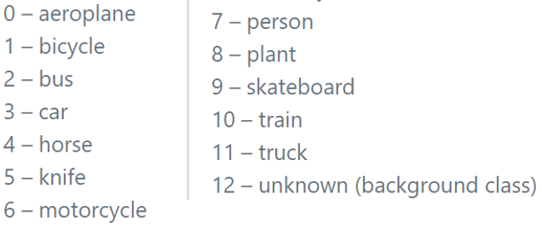
DATA Exploration
Literature Review | Methodology | Implementation | Results | Discussion
Notes:
Visda 18 dataset presents a challenging domain adaptation task. The source domain contains 78,222 synthetic images rendered from 3D CAD models, across 13 object categories, while the target domain contains 5,534 real images.

Slide 11
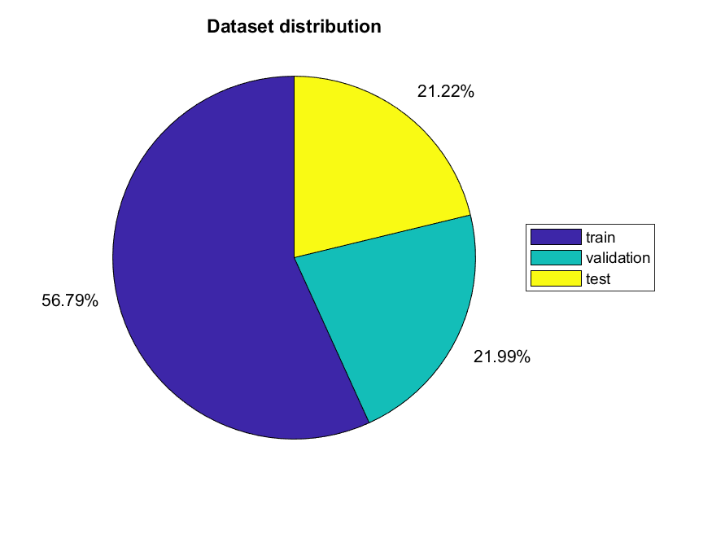
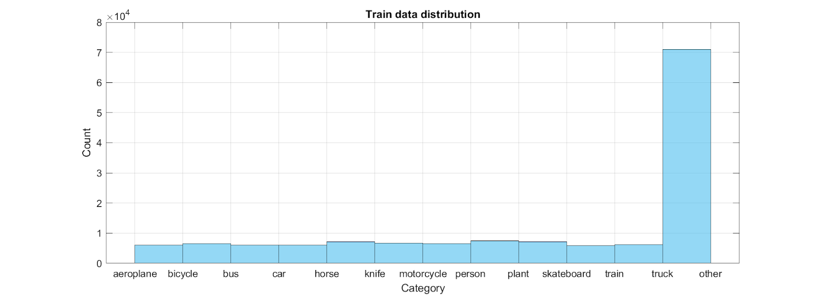
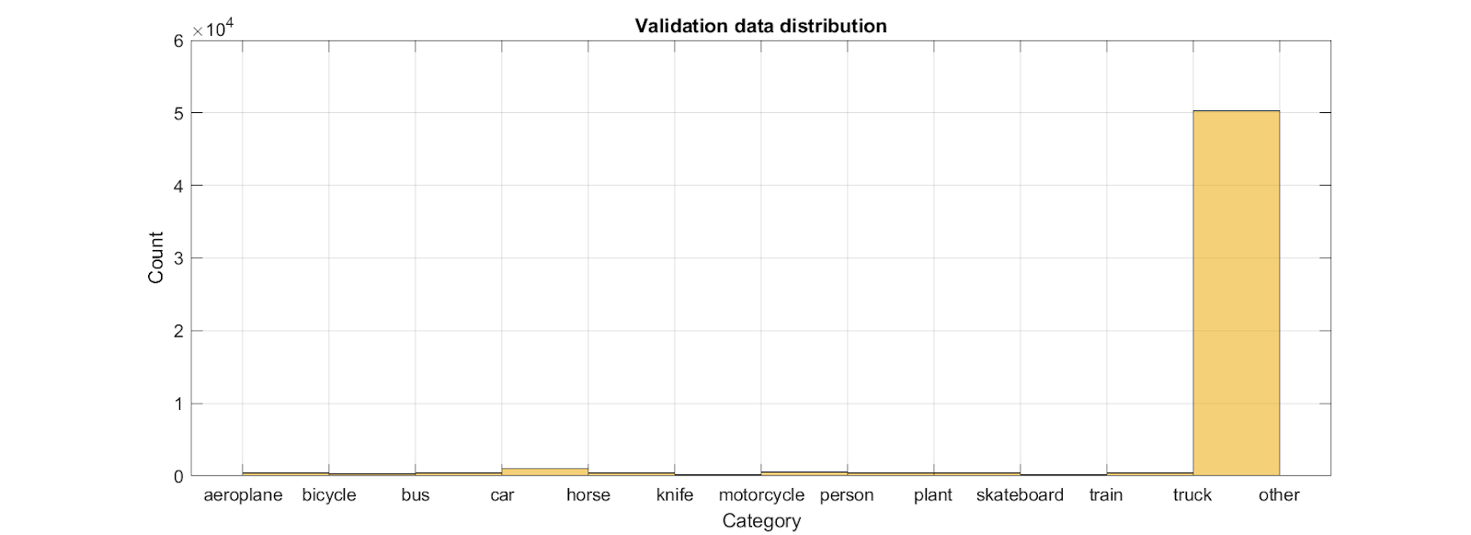
DATA Exploration
Literature Review | Methodology | Implementation | Results | Discussion
Notes:
Here is the distribution of train, validation, and test dataset images. However, only train and validation has ground truth labels. When we analyze the label distributions, it is clear that there is a large bias in the data. Most of the data has a labeling of unknown category.

